Slide 1
Efficient Task Scheduler With Algorithms
Presented to –
Dr. Tania Sultana
Senior Lecturer
CSE
CSE246(4)
Presented by –
Sihab Bin Sarwar(2023-1-60-043)
Ifteayj Ahmed(2022-1-60-002)
Shahriar Rahman(2022-1-60-044)
Abu Baker Siddik(2022-1-60-044)

Slide 2
0/1 Knapsack (DP)
Greedy
CONTENTS
Topological Sort
Comparing All

Slide 3
Introduction
Goal
Solution
Prioritize and order tasks within time constraints
Algorithm-powered scheduler
Problem
Real-life use case
Managing tasks in a busy schedule
I'm always busy — this tool helps me decide what to do, when, and how.

Slide 4
Project Objective
Maximize important task coverage
Compare algorithmic strategies
Choose the best strategy for my schedule
Schedule tasks within a fixed time limit
Handle task dependencies

Slide 5
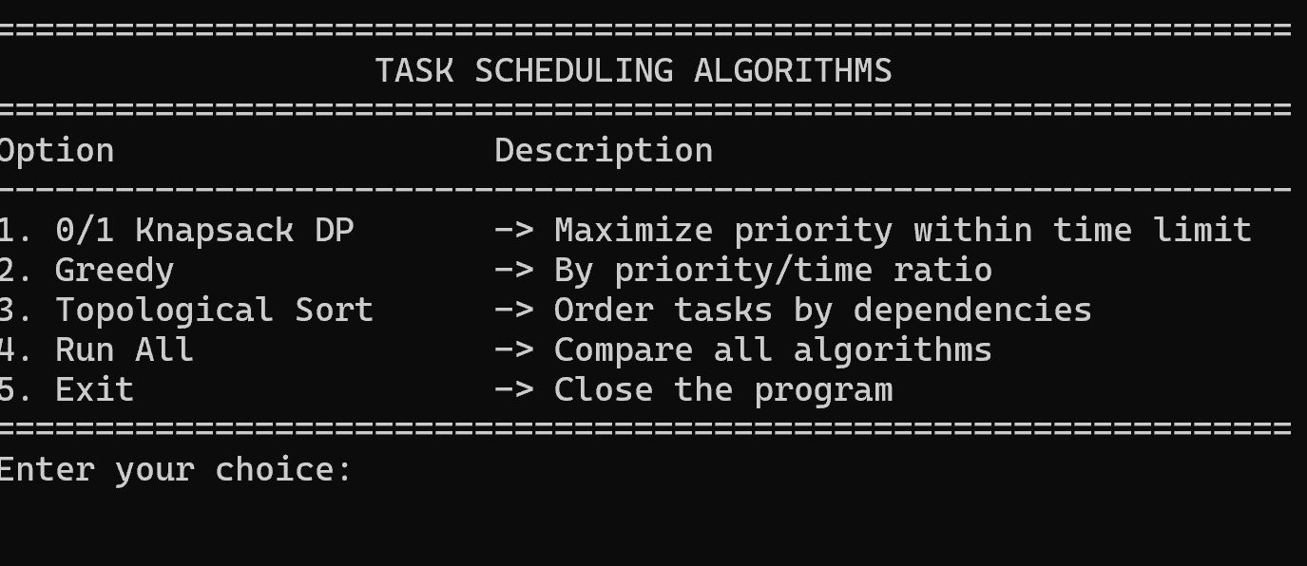
Opening Dashboard

Slide 6
0/1 Knapsack (DP)
Maximize total priority within time limit
Purpose
1. Chooses combination of tasks giving highest total priority 2. Considers all subsets (via DP table)
Process
When total impact matters and time is limited
Best For
I want to finish the most important set of tasks today
Use Case

Slide 7
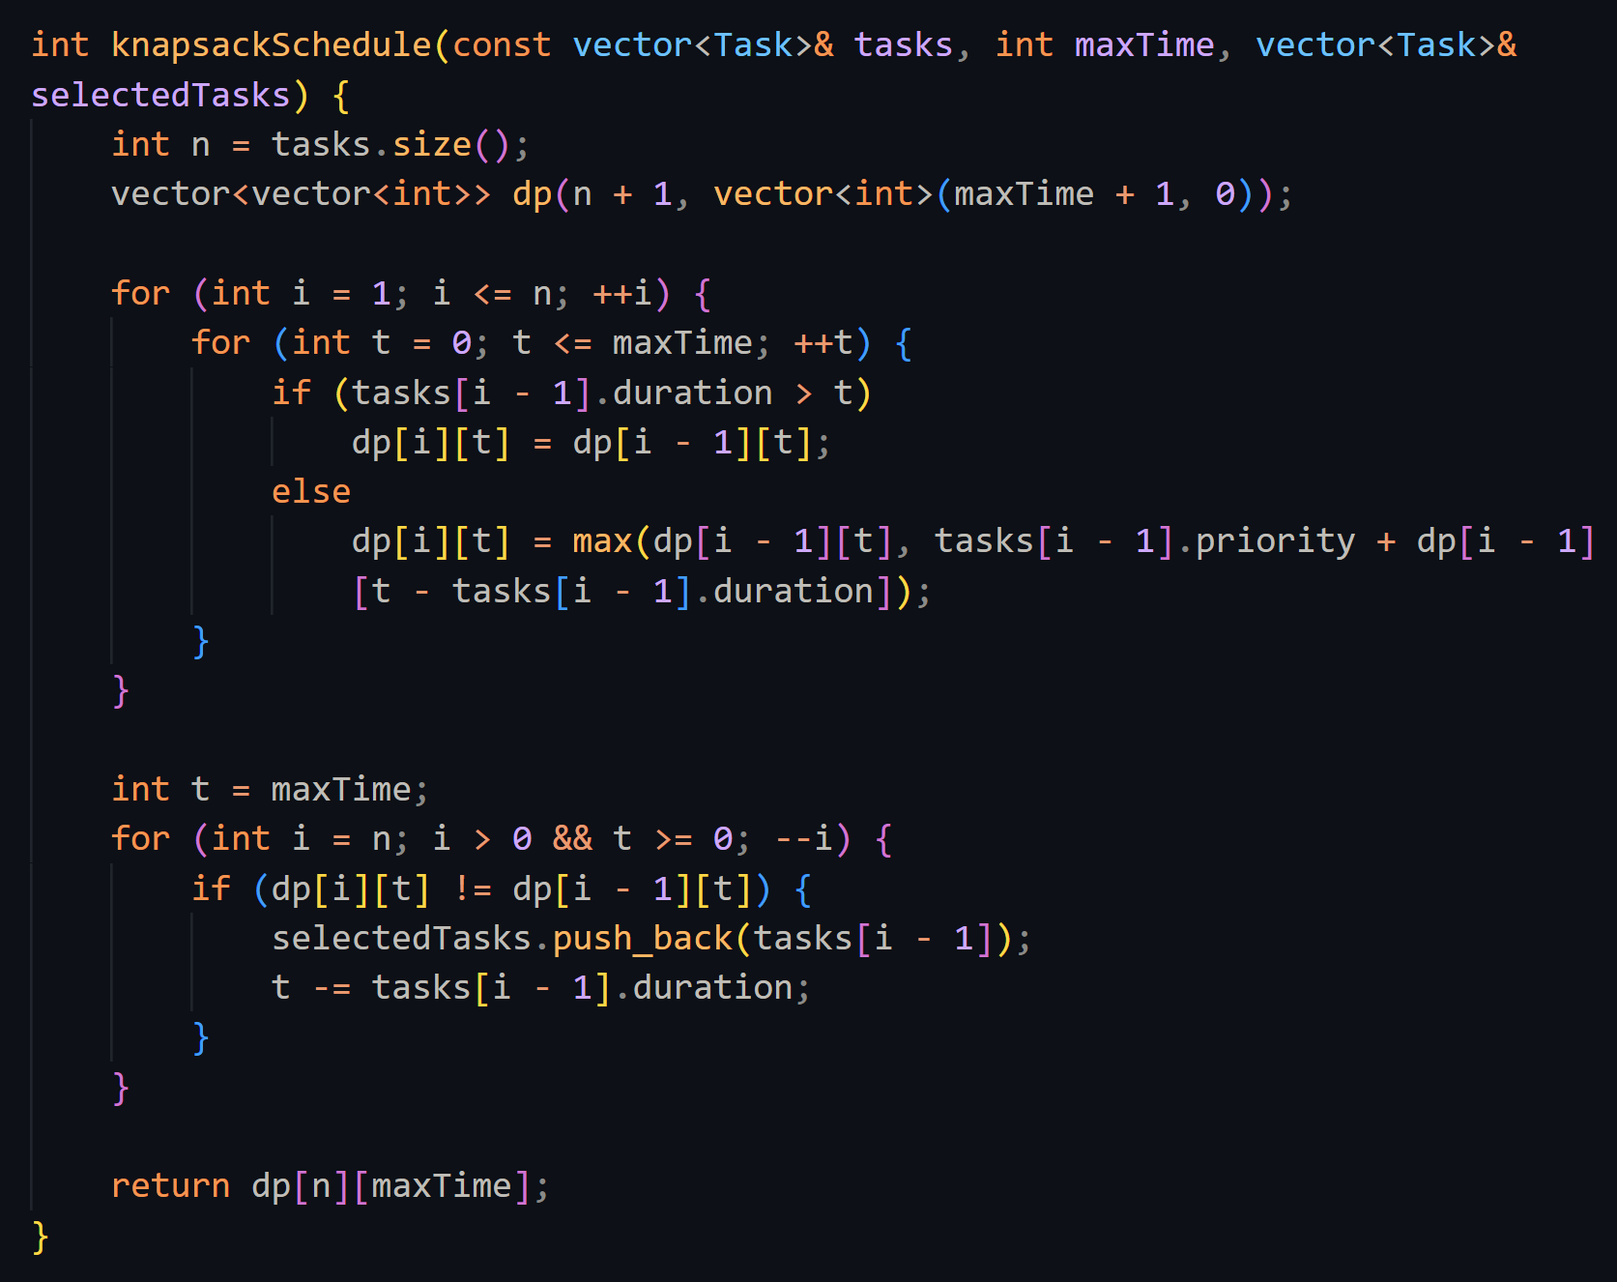
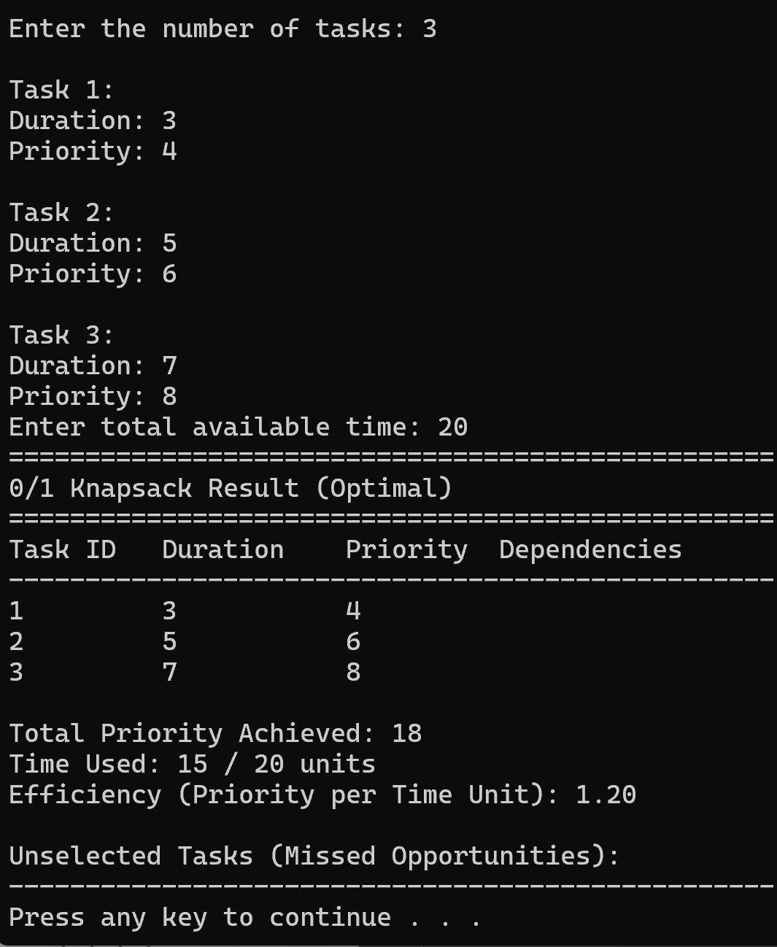
Knapsack – Snippets

Slide 8
Knapsack – Result
Time Used
Total priority & used time
Slow if tasks or time range is huge
Result Console Shows
Drawback
Optimal selected tasks

Slide 9
Greedy Heuristic
Purpose
How it works
Quickly select tasks with best value (priority/time)
Best Result
Sort tasks by priority/duration ratio
When in a hurry — fast, decent result
Uses For
Pick as long as time is left
I have 30 mins between meetings — what’s best to do fast?

Slide 10
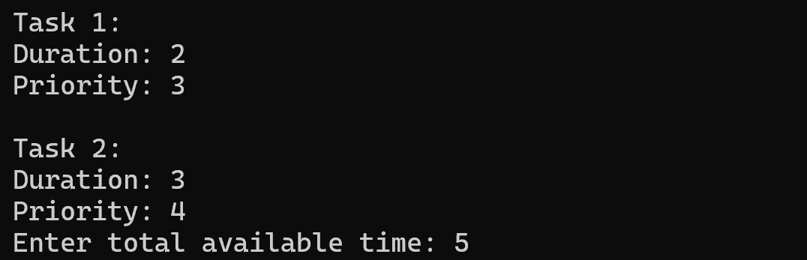
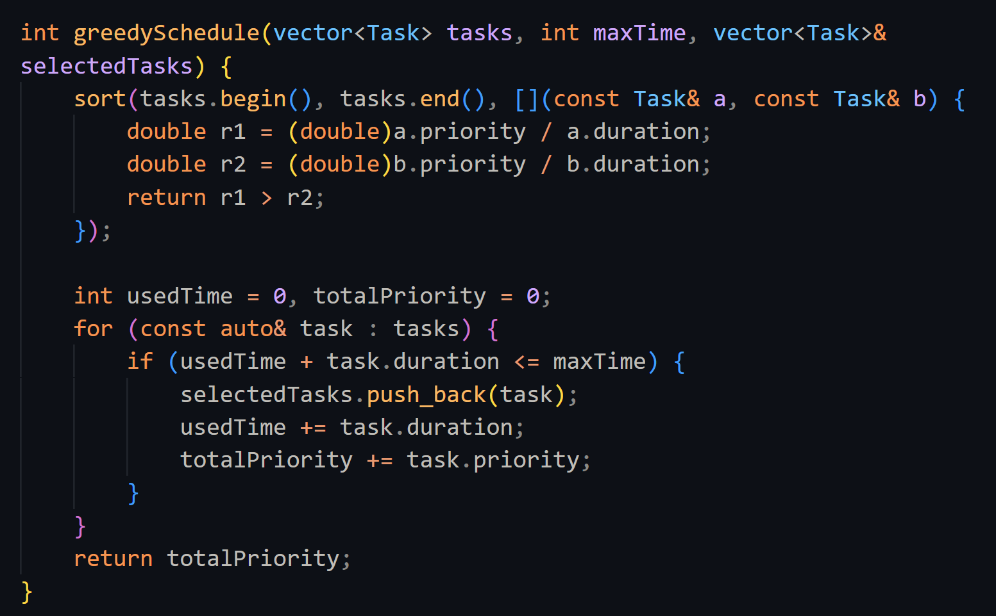
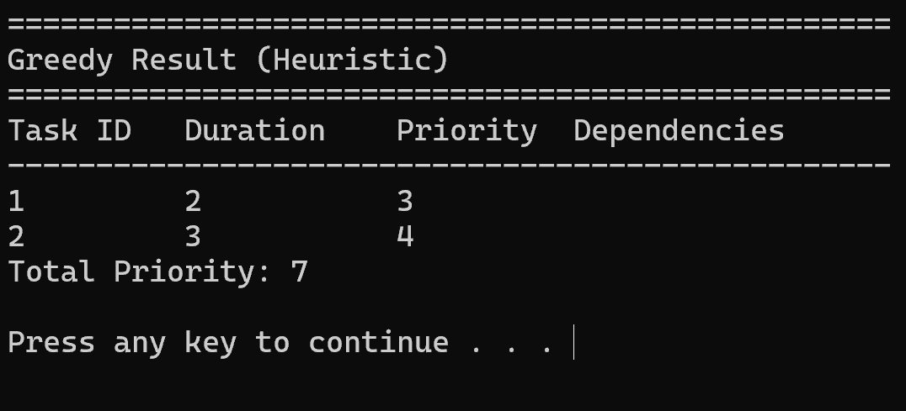
Greedy Snippets

Slide 11
Greedy – Result
Result Console Shows
Drawbacks
1. Fast selection
2. Simple logic, easy to interpret
Not always optimal

Slide 12
Topological Sort
Purpose
How it works
Handle dependencies
Best For
Orders tasks so that no task is done before its prerequisites
Project work, code builds, complex workflows
Use Case
Uses in-degree and adjacency list
Task 3 depends on Task 1 – finish in right order

Slide 13
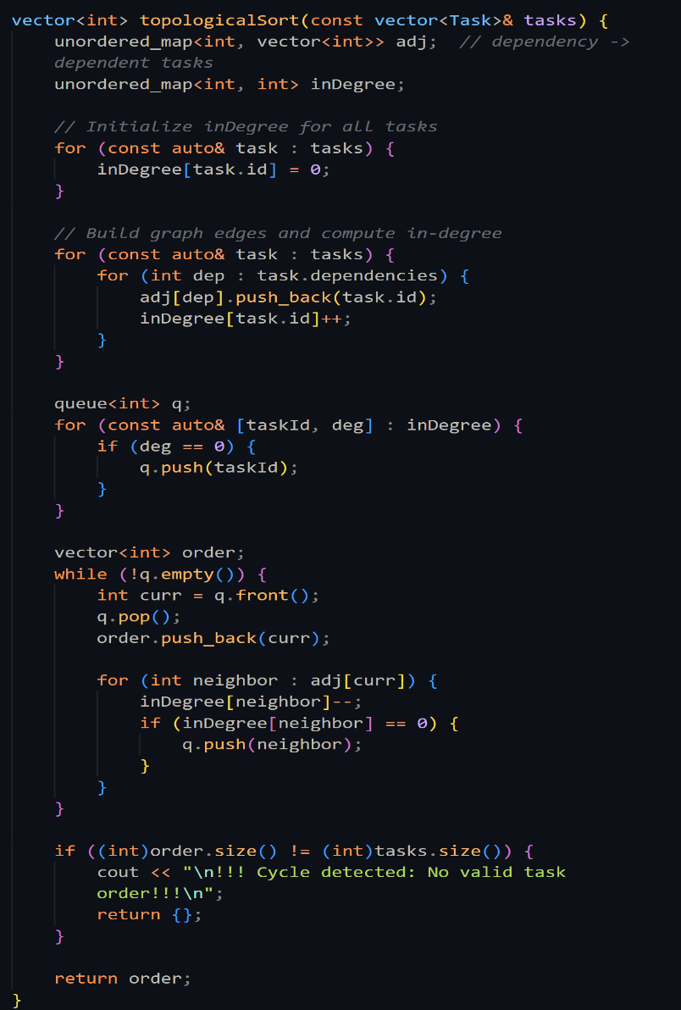
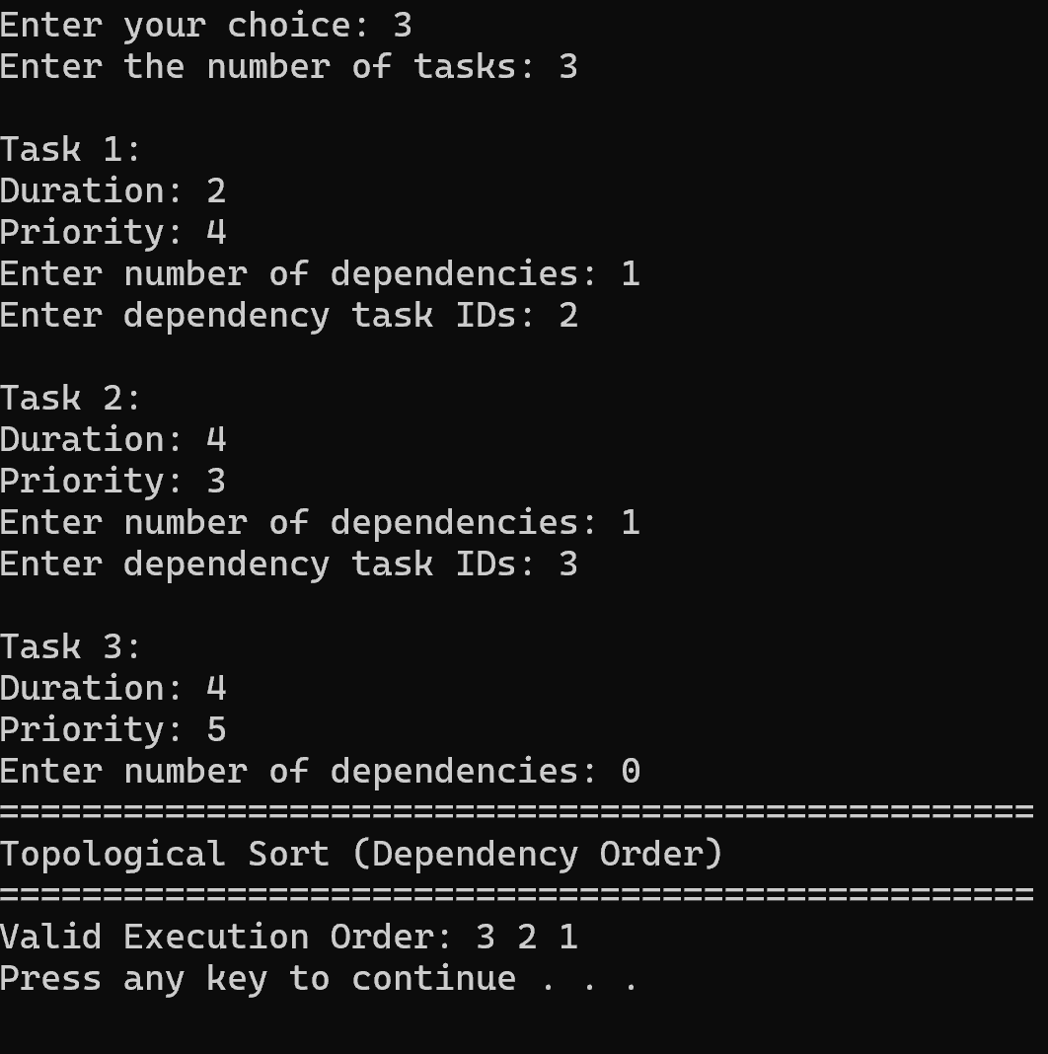
Topological Snippets

Slide 14
All Algorithms Compared
Knapsack DP
Greedy
It’s not as fast as the other algorithms. But it’s optimal. Knapsack can not handle dependencies.
Greedy is one of the fastest algorithms. But it can not handle dependencies or it’s not optimal either.
Over View
Topological Sort
Use Case Match
Only topological sort is fast and can handle dependencies.But the drawback is it’s not optimal
Knapsack: Prioritize best outcome
Greedy: Emergency quick scheduling
Topological: Complex workflows

Slide 15
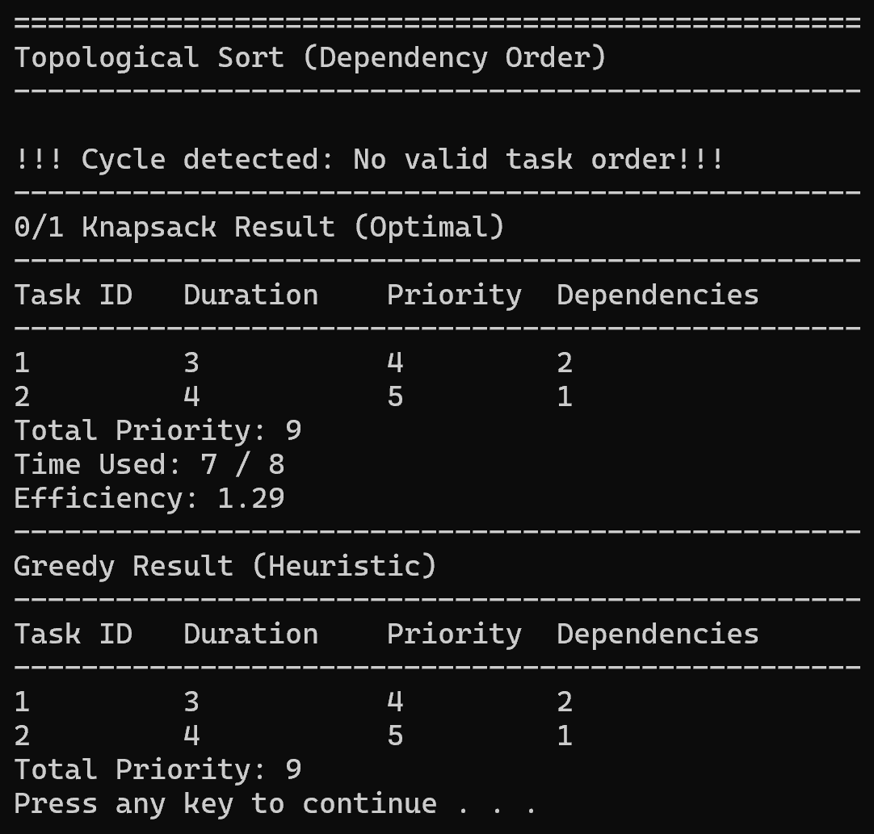
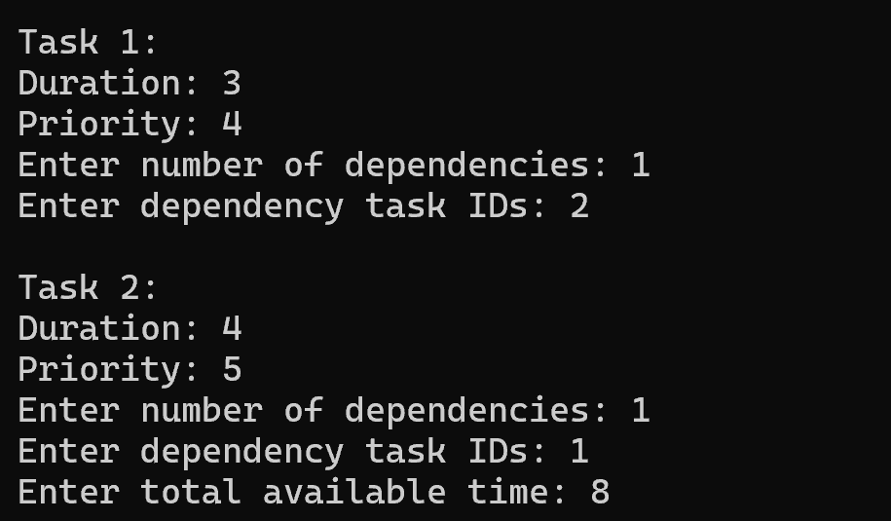
All Algorithms Compared- Console

Slide 16
Thank you

